Slide 1



GILLVRAY HEALTH HACKATHON
CHALLENGE : SPIKES
HEALTH TECH AI HUB
2026
SPIKES
CGM insights for healthier days

Slide 2
GILLVRAY HEALTH
The Data:
  20 patients · 14 days · reading every 5 minutes
  OURA wearable data + self-reported lifestyle scores
  Clinician-labelled priorities & interventions
Gillvray Health:
A pioneering lifestyle medicine clinic from Cambridge — dedicated to preventing and reversing chronic disease through personalised, whole-person care across 6 pillars: Sleep, Nutrition, Movement, Stress, Connection & Habits
The Objective:
  Use AI to extract patterns from glucose spikes and predict which lifestyle pillar needs the most urgent clinical attention
2

Slide 3
— BUILT BY TEAM SPIKES, UNIVERSITY OF BIRMINGHAM
"14 days of glucose data. One clear clinical story. In under 3 seconds."
Meet SPIKES Wellness!
🧬Personalised Detection
🎯6-Pillar Prediction
⚡Empowering Clinicians
3

Slide 4
FROM RAW DATA TO CLINICAL ACTION
RAW DATA
DETECT
PREDICT
ACT
Raw Data 14 days · 288 readings/day · 5-min intervals CGM + OURA wearables + self-reported pillar scores
Detect FFT baseline + ±1 SD dual-tier spike detection 36 features engineered across 4 time windows Amplitude · Gradient · Duration · iAUC · CV
Predict Rule-based weighted ranking across all 6 pillars Validated with Spearman correlation + MARE against clinician-labelled ground truth
Act Personalised pillar priority score per patient Full intervention shortlist · under 3 seconds
4

Slide 5
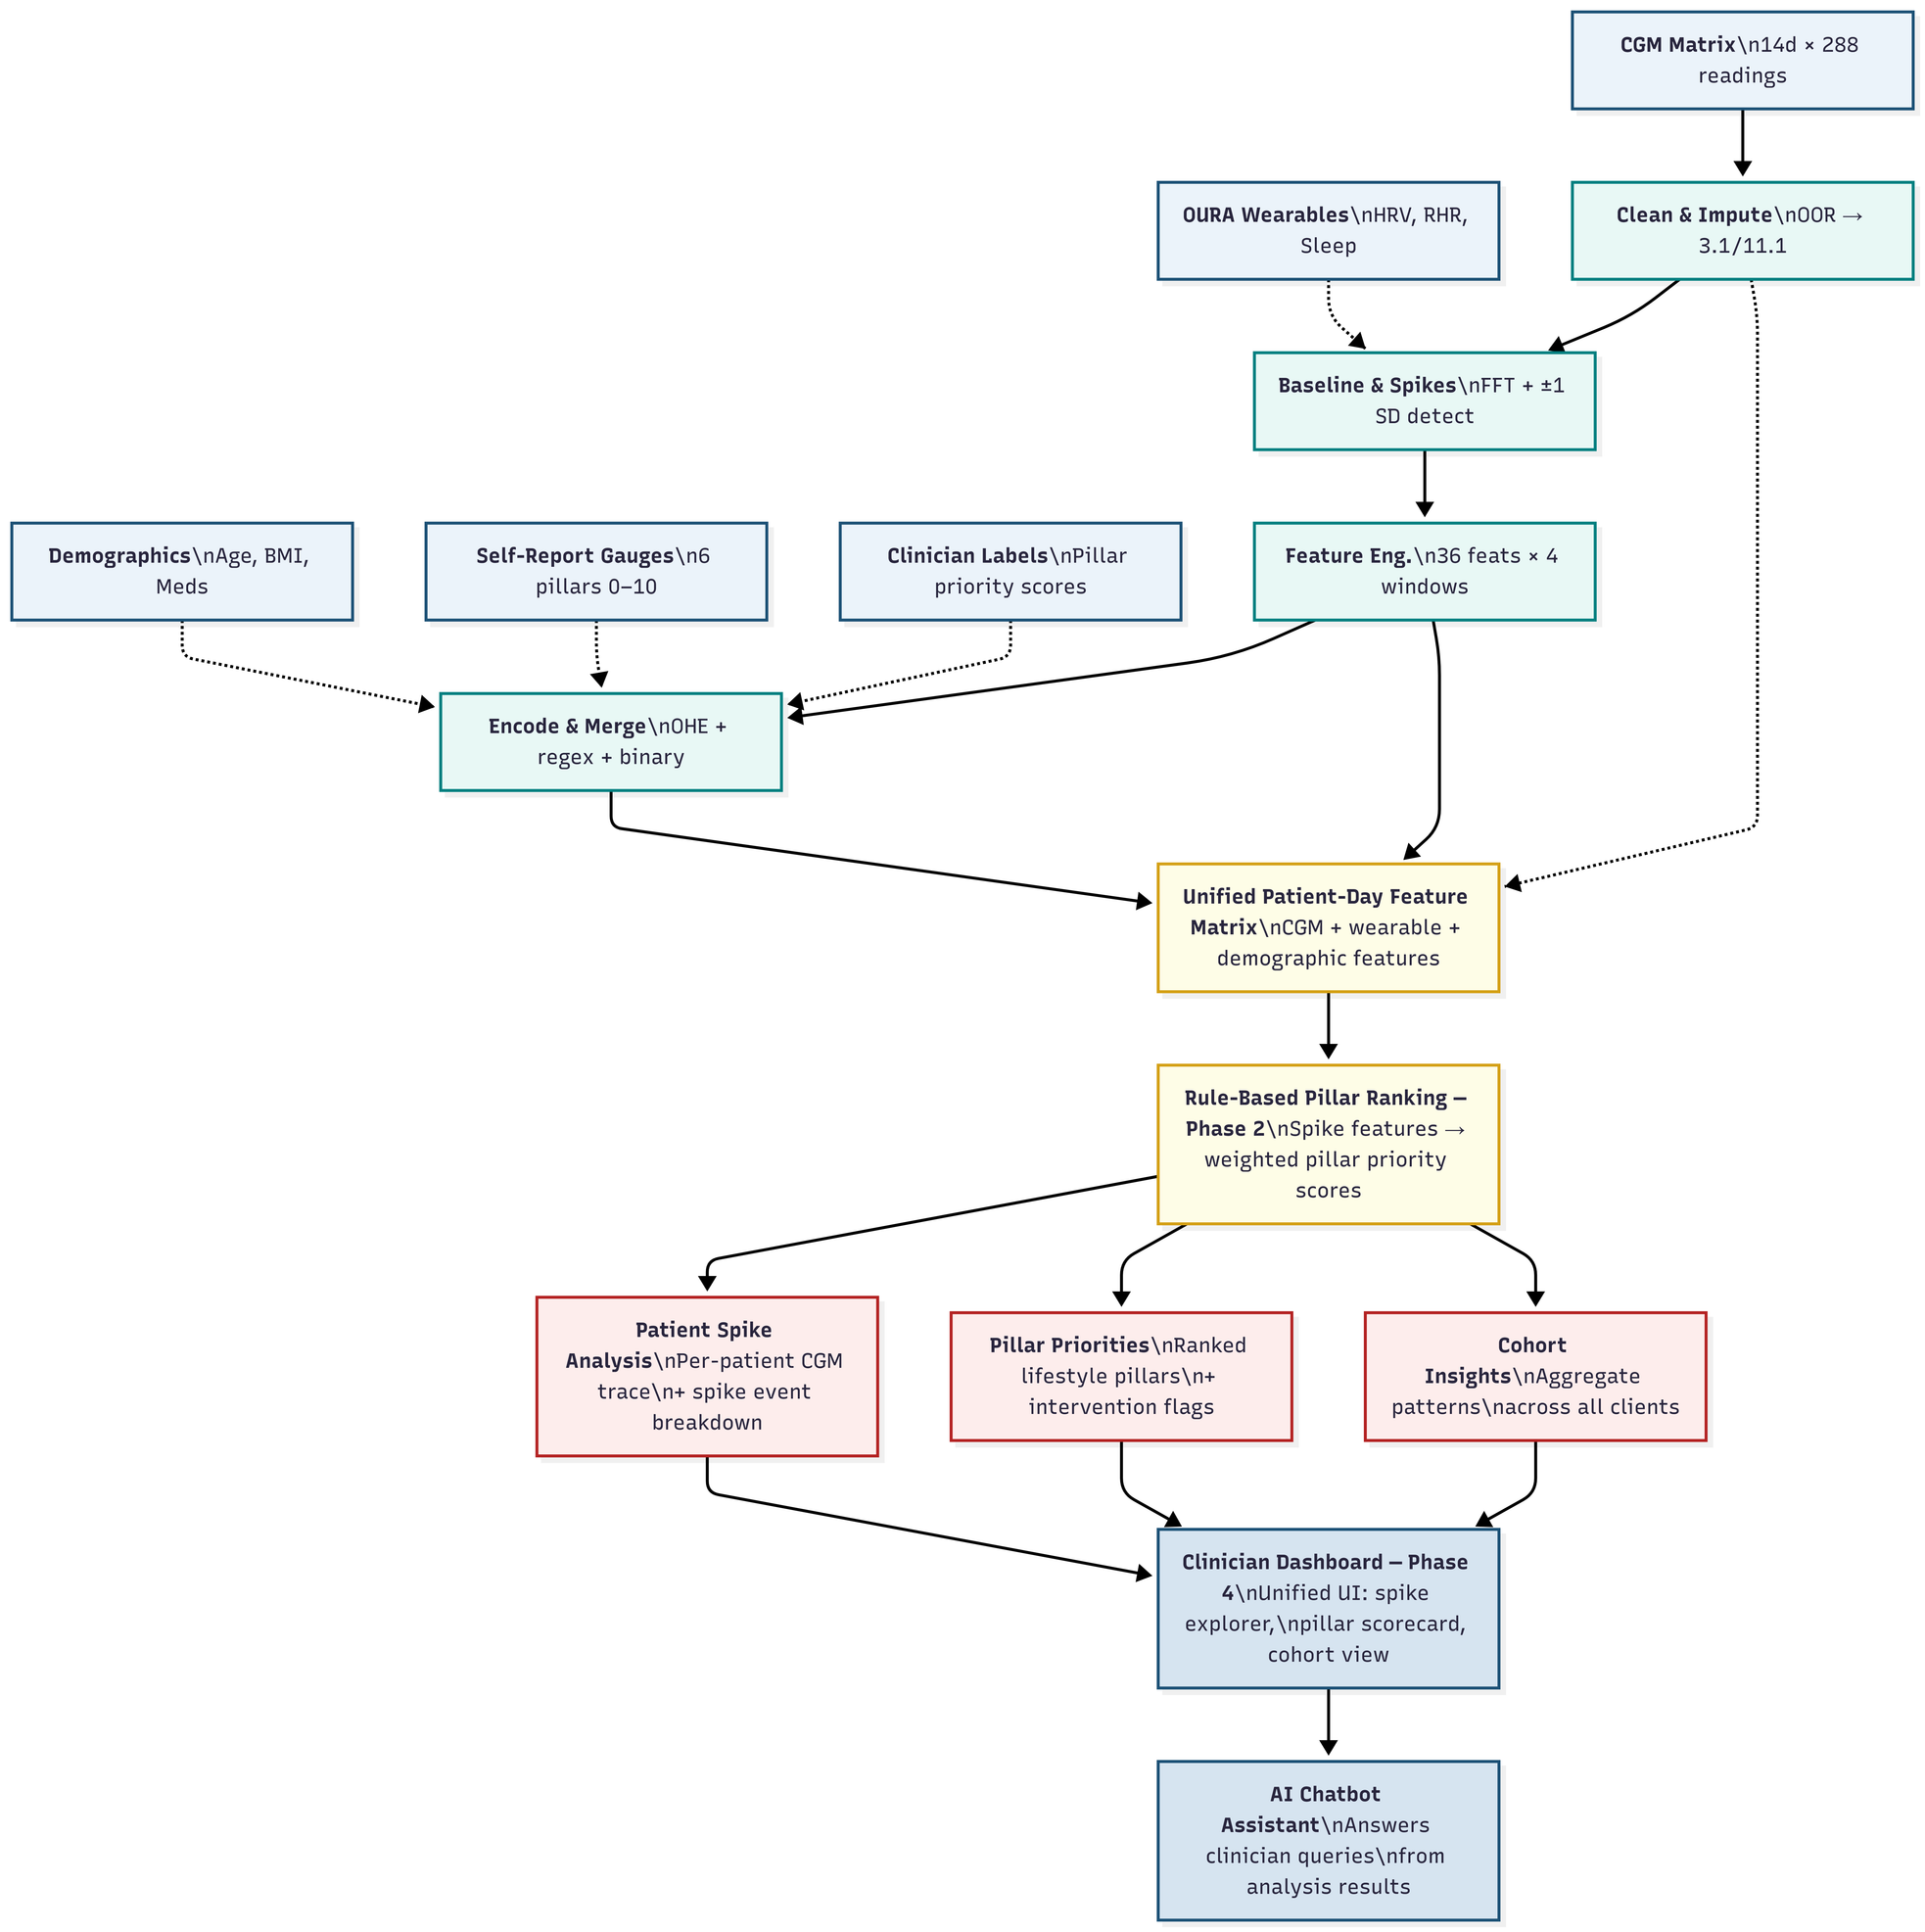

Slide 6
DEMO
6

Slide 7
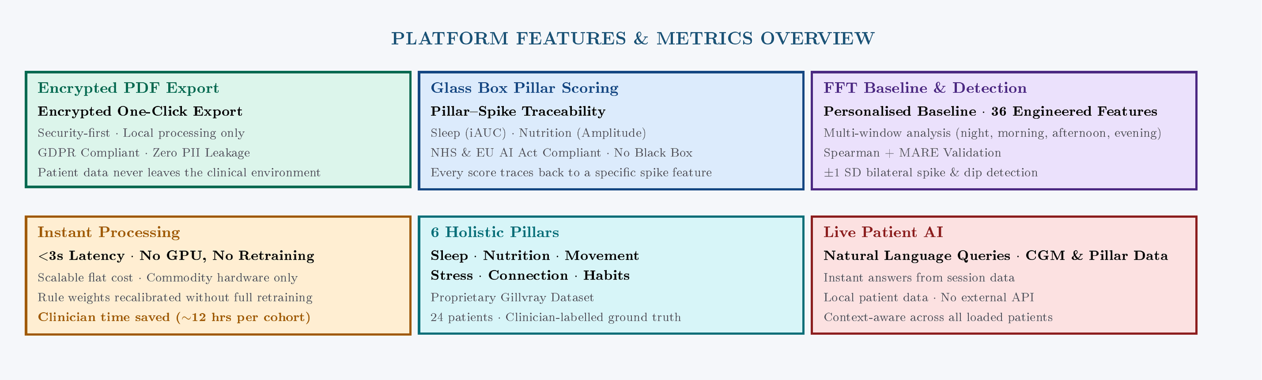

Slide 8
WHAT WE STAND FOR
“AI is not here to replace us. It is here to empower us.”
8

Slide 9
MEET THE TEAM
BASAVARAJ NADUVINAMANI
BRYNLY
CASMIR OBI-OSUALA
KASHIF AYAZ KHAN
LOUISE (MIGUEL) ALBURO
PUNEET MISHRA
SIDDHARTH MUKUNDAN
SHIVAM TIWARI
THANK YOU!
9

